Slide 1

FALL WORKSHOP 2025 DISTRICT ELEVEN CHANDLER, AZ

Slide 2

AGENDA
Leadership
Onboarding
Succession Planning

Slide 3
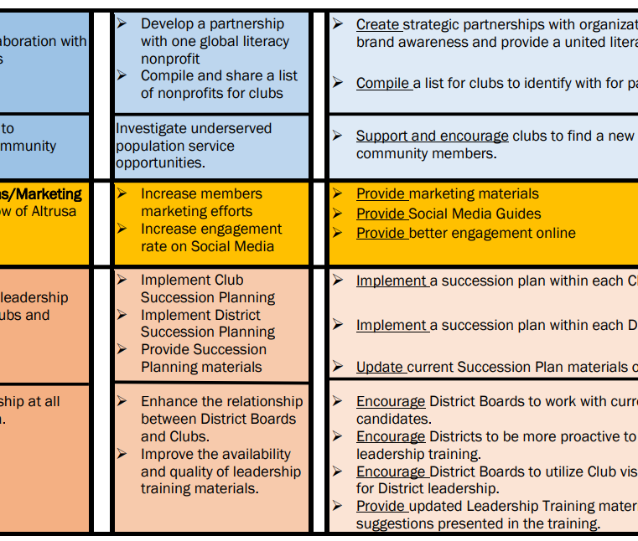

ALTRUSA INTERNATIONAL STRATEGIC PLAN 2024-2030

Slide 4
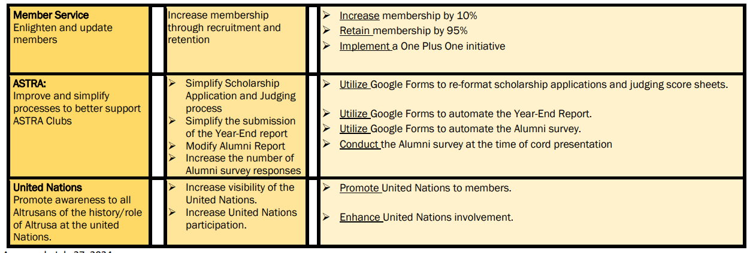
CONTINUED

Slide 5
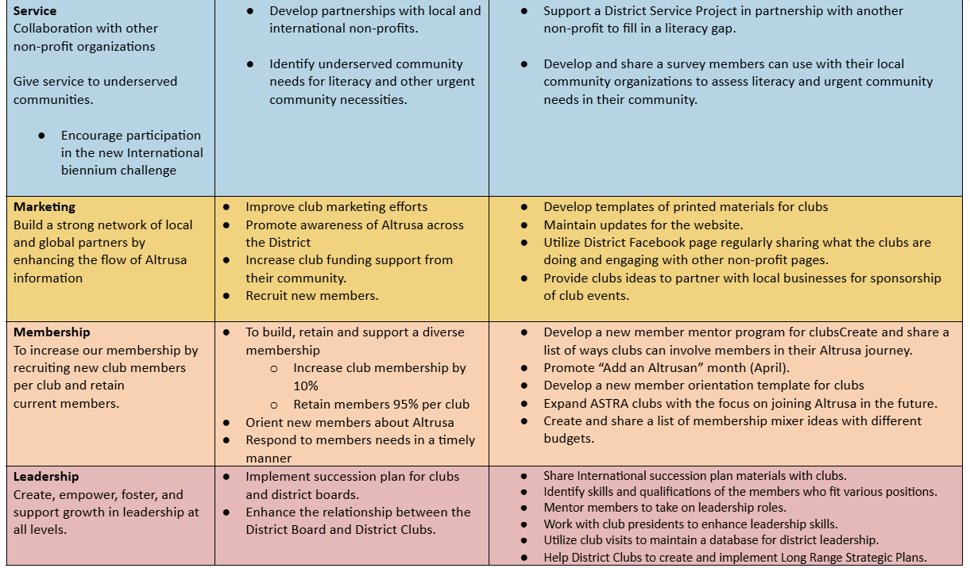
DISTRICT ELEVEN STRATEGIC PLAN 2025-27

Slide 6
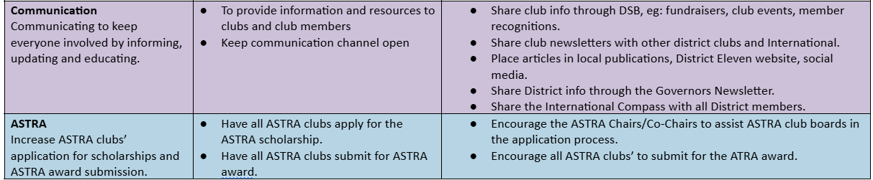
CONTINUED

Slide 7

LEADERSHIP “YOU DO NOT MOTIVATE PEOPLE. YOU CREATE AN ENVIRONMENT IN WHICH THEY CAN MOTIVATE THEMSELVES” DAIVD RICHARDSON

Slide 8

LEADERSHIP THROUGH MOTIVATION
Motivation through discovery
Self-Motivation
Motivations Styles
Notes:
Motivation is the process to help people discover how they can benefit from doing something. The goal is to use your enthusiasm to assist others to be self-motivated. Each person have different motivation styles.

Slide 9

WHAT MOTIVATES YOU TO BE AN ALTRUSAN?
WHAT MOTIVATES YOU TO CONTINUE BEING AN ALTRUSAN?
Notes:
Take about 10 minutes to list what motives you to be an altrusan and what motivates you to continue as an altrusan.

Slide 10
LEADERSHIP
Inspiring and Fostering Positive Environment.
What does leadership teach you?
Inclusive Cultures of Belonging
The three R’s
Recruit
Retain
Reward
Notes:
At the heart of successful volunteer organizations are effective leaders of volunteers who guide, motivate, and support their teams. Being a leader of a volunteer organization is not just about managing task; it involves inspiring others and fostering a positive environment. Why does Altrusa need leaders? Volunteer leadership is a powerful catalyst for both personal and professional growth. Leadership teaches you how to lead with authenticity, adaptability, and compassion, while making a meaningful contribution to the world. In your personal life It should bring you fulfillment and purpose. Being a leader in a volunteer organization teaches the power of inclusion and success depends on the collective effort to a diverse group. The three R’s are recruitment , retainment, and reward. How effective is your recruitment and retainment of members? How is the service work rewarded?

Slide 11

SIMPLIFY LEADERSHIP
There is no one size fits all!
Do you have to fill all the roles?
Don’t try to please all!
Keep your word.
Make time for what is important.
Don’t burn out your leadership!
Find out what skills membership have.
Skills Test
https://www.bizlibrary.com/soft-skills-assessment/.
Soft Skills Assessment
Notes:
Complete the workshop reflection worksheet. Talk about the answers. Take the skills test.

Slide 12
ONBOARDING

Slide 13

ONBOARDING
All aboard!
Altrusa no longer just orientates new members we onboard new members…

Slide 14

RETAINING NEW MEMBERS THROUGH MENTORSHIP & LEADERSHIP -MELINDA AGUIRRE CONVENTION 2025
Beyond Orientation
Integration
Alignment
Belonging
This leads to...
Involvement & engagement
Relationships & trust
Contribution
Future leaders
Notes:
The foundations of effective onboarding moves beyond a meeting or presentation it involves learning, relationship-building, and hand-on participation. Onboarding gradually introduces the member to the club's culture, expectations, and opportunities. The first goal is integration assisting the new member to be fell apart of the team. Alignment connects personal goals with Altrus’a mission. Lastly, belonging builds trust and connections with other members. Why does this matter? It matters to make members feel welcomed and supported which the member is more likely to stay. Onboarding builds stronger relationships, deeper engagement, and future leaders. It ensures every member knows who to contribute meaningfully from the start.

Slide 15
BREAKOUT GROUPS

Slide 16
WHAT ARE SOME WAYS YOUR CLUB CAN… OR ALREADY DOES
Tables 1 & 5 Get new members involved
Table 2: Help new members align with our mission & vision
Table 3: Make new members feel like they belong
Table 4: Develop new members’ leadership skills

Slide 17
LUNCH

Slide 18
MENTORSHIP

Slide 19
POWER OF MENTORSHIP
WHY?
Reduces uncertainty & Builds confidence
Fosters faster learning & social integration
Increases long-term engagement & retention
Engages seasoned members
Mentorship is not about hierarchy-It’s about human connection. In nonprofits, mentorship is the quiet power that transforms participation into purpose and members into leaders.
Notes:
Why does mentorship matter? It reduces uncertainty and builds confidence. New members know who to go to with questions, helps ease the stress of “figuring things out”, and encourages early participation without fear of mistakes. Mentorship fosters faster learning and social integration. Mentors explain “Unwritten rules "and how things work, builds quick connections with the club and it members, and makes clubs feel friendly, familiar, and approachable. It increases long-term engagement and retention by mentoring member. The mentorship makes them feel supported and valued. It encourages deeper commitment and future leadership along with reducing drop-off after a few months. The mentor’s role is to be a guide, not just an instructor. They balance direction with empowerment and advocate, listen, and provide feedback to the mentor.

Slide 20
LEAD THROUGH EXAMPLE & INTENTION
Demonstrate High Standards Through Action | Set the Tone for Professionalism & Positivity
Be consistent, prepared, & reliable | Be available & approachable
Model communication, collaboration, & learning | Consistency & feedback
Notes:
Practice what you expect from others, lead with integrity and follow through, be someone others can learn from by watching. Lead by showing up on time and be ready to contribute, follow through on promises and commitments, and create trust by being dependable. Communicate respectfully and clearly, stay solution-focused and encouraging, and represent the club’s values in your words and actions. Lead by being available for questions, check-ins, and conversations. Create a safe space where others feel comfortable reaching out and listen actively and respond with support. Communicate clearly, respectfully , and often. Collaborate openly_ share credit and invite in-put. Admit when you do not know something and show curiosity. Lastly, have regular 1:1’s, create a safe space for questions, provide constructive and kind feedback,

Slide 21
SETTING INTENTIONS

Slide 22
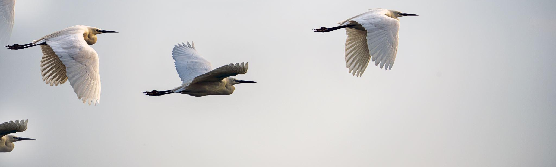
SUPPORT FROM DAY 1
New member mentorship program
Personal connection before participation
Immediate involvement is small roles
Purposeful onboarding
Feedback & inclusion
Recognition & celebration
Ongoing engagement
Notes:
1. Pair each ne member with a seasoned member for the first 6-12 months. 2. Take time to get to know the new member personally. Ask about interest, skills, availability, and motivation for joining, Connect then with a project that aligns with their passions. Celebrate their birthday or life events to build a deeper bond. Don’t overwhelm but do engage. Invite the new member to volunteer for a small, clearly defined task. Recognize and thank them publicly. Go beyond logistics- inspire with mission and impact. Share the “Why” of Altrusa through member stories. Provide a tour of past and upcoming projects with visuals. Let them see how they’ll make a difference. Actively ask new members how it is going. Celebration contributions. Mention new members in newsletters and social media. Give a “Newcomer Spotlight”” or “Rising Star” mention at a meeting. Send handwritten notes of appreciation from leadership. Lastly, keep the momentum going by always offing “next steps”. Offer leadership training, service trips or public speaking opportunities.

Slide 23

SUCCESSION PLANNING
This Photo by Unknown Author is licensed under CC BY-SA

Slide 24
PURPOSE
WHY IS SUCCESSION PLANNING NEEDED?
Assist Altrusa Clubs to have the right leadership team in place!
Notes:
Succession planning is important to get a diverse leadership team. We want leaders who align with the mission, vision, and values of Altrusa. Also, having a succession plan allows clubs to save time recruiting for positions. Succession planning is a process and strategy for replacement planning and passing on leadership roles. It is used to identify and develop new, potential leaders who can move into leadership roles when they become vacant.

Slide 25

WHEN TO START!
NOW
Notes:
Succession planning starts NOW, day one! When onboarding a new member, share expectations of the member to be a leader and inform them of the leader’s roles and responsibilities. Assign a mentor right away. Past Presidents, Past International and District Officers, and Committee Members are great mentors. Sponsor’s role continues as guiding new members through the first months/year, encouraging active participation, and acting as a primary resource. Refer to the Altrusa International website under the Leadership Tab/Mentor’s Toolkit for the mentoring guide, mentor application form, and mentee application form.
First step is Committee work; provide a list of Committees/Committee descriptions and allow members to provide 2-3 choices and try to have a mix of newer and & “Seasoned” members on each Committee. Next steps are future Committees. First leadership roles may be Secretary, Assistant, or Co-Chair of a Committee. This is Phase 1 of Succession Planning!

Slide 26
SUCCESSION PLANNING STEPS
IDENTIFY KEY AREAS AND POSITIONS
IDENTIFY CAPABILITIES FOR KEY AREAS AND POSITIONS
IDENTIFY INTERESTED MEMBERS
DEVELOP AND IMPLEMENT SUCCESSION AND KNOWLEDGE TRANSFER PLANS
EVALUATE EFFECTIVENESS
Notes:
Identify key areas and positions that are critical to the club’s operational activities
and strategic objectives. Identify which positions are critical to achieving current
and future club goals. Identify relevant knowledge, skills, abilities, and
competencies needed for the position. Inform members of the key available
positions, responsibilities, and requirements. Determine who is interested (officer
interest survey, sign-up sheet, or personal outreach). Incorporate strategies for
learning, training, and development into your succession planning. Evaluate
the effectiveness of the succession plan by having a succession plan for all key
positions.
FIRST EXERCISE: Koni &amp; Lina (conversation with a potential candidate for a
leadership role) WRITE UP
Review the Leadership Succession and Transition Plan template:
· Section 1: Leadership Roles &amp; Responsibilities - Sandy
· Section 2: Identification &amp; Development of Successors - Koni
SECOND EXERCISE: Complete a break-out activity by reviewing 4 members ‘ bios to
determine which position(s) each candidate qualifies for and is applicable to
development plan type(s). WRITE UP BIOS
· Section 3: Transition &amp; Handover Process - Lina
· Section 4: Contingency Planning
§ Intro - Koni
§ Emergency Replacement - Sandy
§ Document Access (digital vs hard copy) - Lina
§ Interim Responsibilities - Koni

Slide 27
LEADERSHIP TRANSITIONS
Engage the boards and members
Identify current challenges
Timeline for leadership succession
Identify leadership development opportunities
Cross-train members
Support members in new leadership positions
Onboarding for leadership positions
Notes:
Look to previous committee chairs to serve as club director. A club director to
move up to secretary or vice president. Club treasurers may serve for 2 years; at
At the beginning of the 2nd year, elect an assistant treasurer to shadow - then step up to
treasurer for 2 years. Clubs may choose to have a president, president-elect’s vice
president, while others only have a president and vice president or president-elect.
Consider co-presidents, serving together for 1 year, then one moves on to the past
The president and another co-president are elected.
Identify Leadership Development opportunities: Immediate past president is a
great mentor resource. Assign board members to club committees as liaisons -
Good opportunity to look for future leaders. Committees help identify members’
passions (s) and skills, and committee/project work allows current leaders to
identify future club leaders. Current leaders may need to take a break, but don’t
forget about them for future positions! Nominating Committee observes
members for several months, looking for good candidates - make note of meeting
attendance patterns! Talk with mentors of potential candidates, get feedback.
Provide Leaders with Tools, Resources, and Training to be successful leaders.
Samples of agendas, format for minutes &amp; financial reports, expense vouchers.
Timelines for meetings, deadlines for clubs, district &amp; international. Instructions
for group tally, club storage of materials, club email address, websites &amp; social
media. Utilize Cross-Training, Shadowing, Serving as Project Lead, and Hands-On
Practice or Archival Tasks to develop skills required for a specific leadership role.
Training offered at District Conference and workshops, and International
Convention, materials on the Altrusa International website/Leadership section, and
articles in the Compass, Governor’s Newsletter, and Club Newsletter. We can
provide training and development planning to get them ready for their next
leadership role.
Support members in new leadership positions; ensure they have the tools needed,
check in and provide help/mentorship. Provide recognition, both verbal &
spotlight in club newsletter; appreciate their achievements and successes.

Slide 28
Resources for Altrusa International Website
Article in July 2024 Compass, Volume 7, Issue 4
Succession Planning by Tammy Boyd, International Leadership Committee Co-Chair.
https://login.altrusa.org/altrusa-compass/altrusa-compass-volume-7-issue-4/.
· Article in January 2025 Compass, Volume 7, Issue 6
Mentoring: Why is it important to Altrusa by Shannon Schell, Immediate Past Governor
District Three, Leadership Development Committee Member
https://login.altrusa.org/altrusa-compass/altrusa-compass-volume-7-issue-6/.
· District Position Descriptions
https://login.altrusa.org/files/2019/02/District-Position-Descriptions -01-2019.pdf.
· Club Position Descriptions
https://login.altrusa.org/files/2019/02/Club-Officer-position-descriptions-01-2019.pdf.

